Slide 1
QMS Version 3 Overlay Handling for measurements on Image ( A Solid Works - ANSI perspective)

Slide 2
1. Default Overlay Representation

Slide 3
Line
Line segment
Circle/Arc
Center
Crosshair outer
Crosshair inner
Point
Dot
Converge

Slide 4
Direct Metrics
Distances
Line to line
Point to point
Point to line
Diameters and Radii
Circles
Arcs
GD&T Metrics
Perpendicularity
parallelism
Symmetricity
Circularity
Concentricity
Circle Datum
Line Datum

Slide 5
2. Overlay Adjustment

Slide 6
2. i. Degrees of freedom

Slide 7
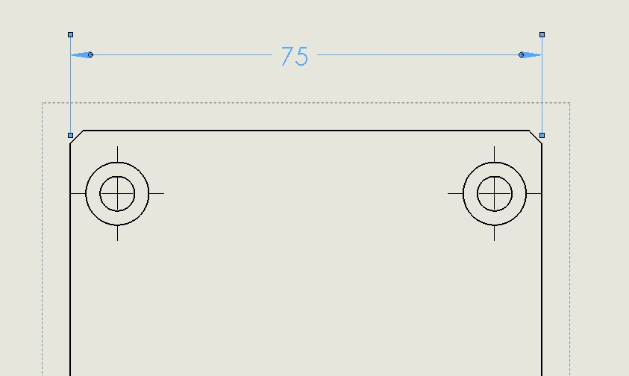
1. Degrees of freedom (Distance)

Slide 8
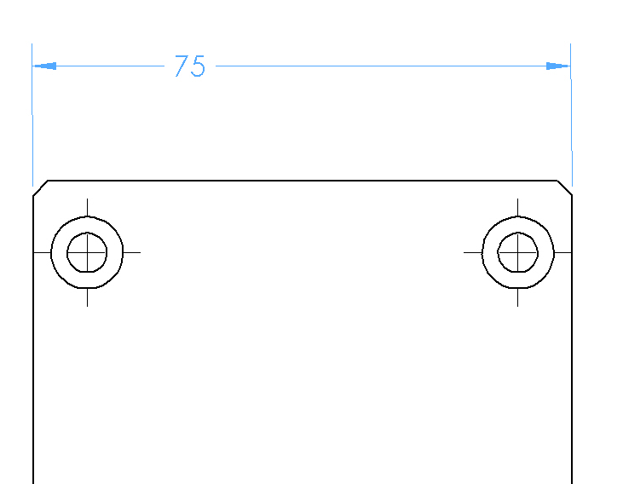
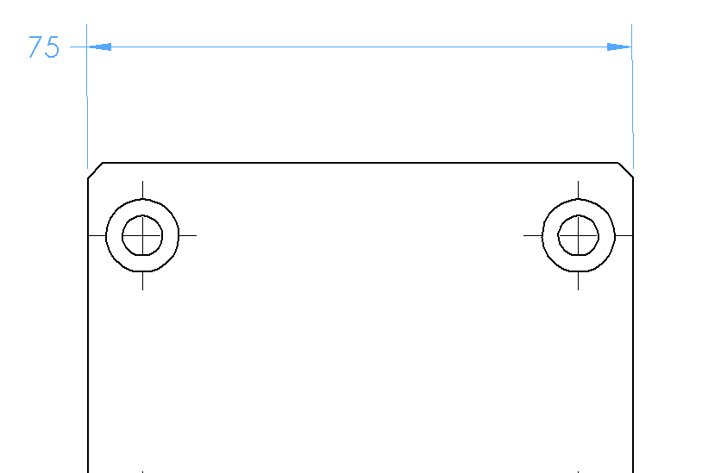
Degrees of freedom (Distance)

Slide 9
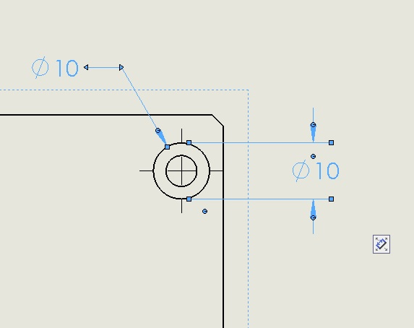
Degrees of freedom (Diameters & Radii)

Slide 10
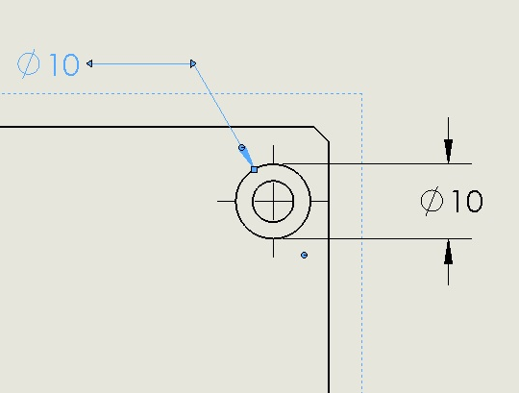
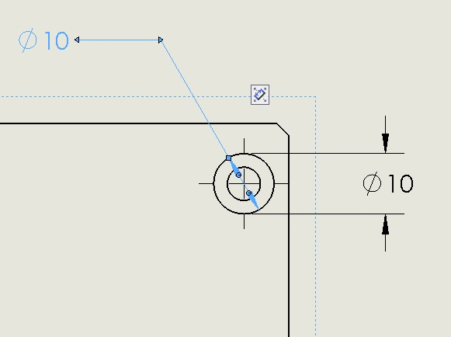
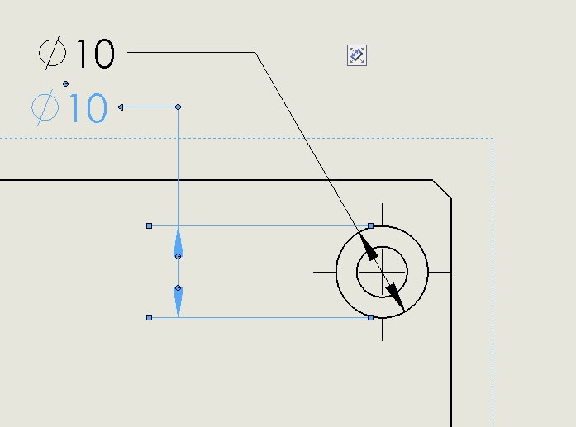
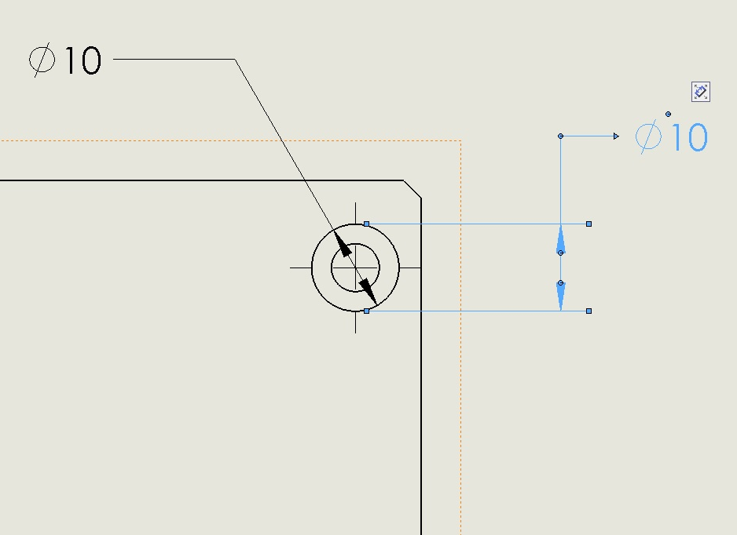

Slide 11
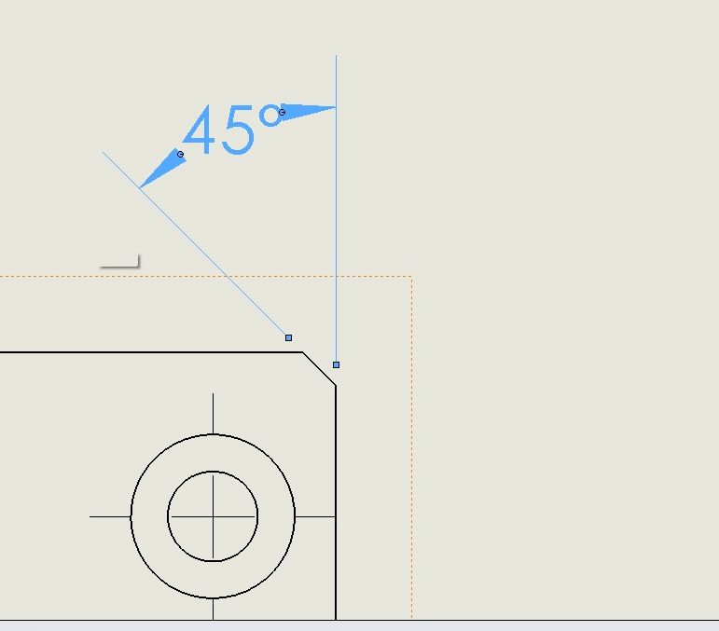
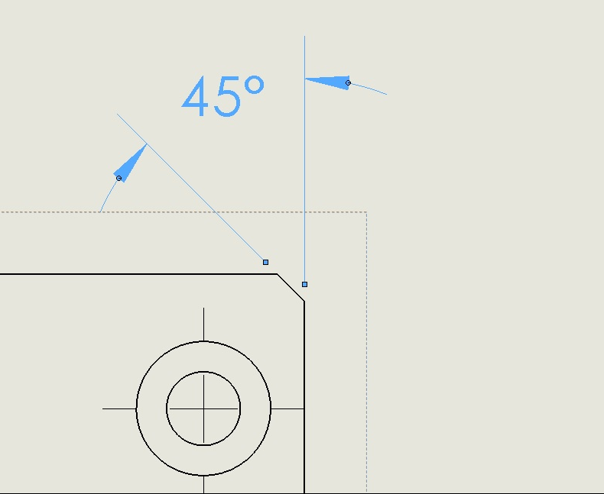
Degrees of Freedom (Angle)

Slide 12
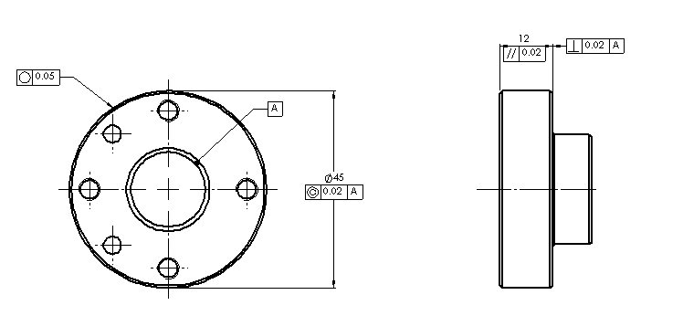
Degrees of freedom (Indirect metrics)

Slide 13
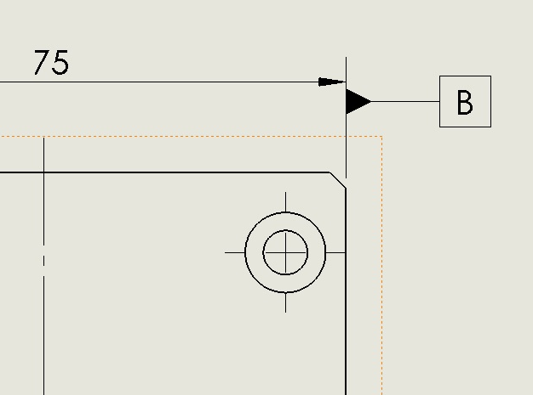
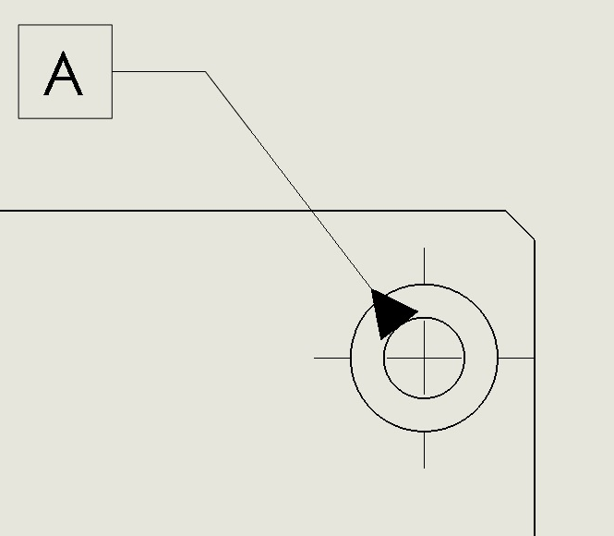
Degrees of freedom (Datum)

Slide 14
2. ii. Out of canvas manipulation case

Slide 15
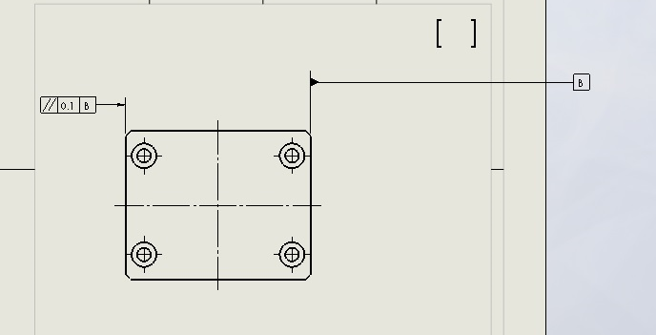
Out of canvas manipulation case

Slide 16
Out of canvas manipulation possible solutions
Re-adjust to the nearest canvas border
To the nearest boundary of image
To the previous position
Increase canvas size
Unidirectional
All sides

Slide 17
2. iii. Zooming Experience

Slide 18
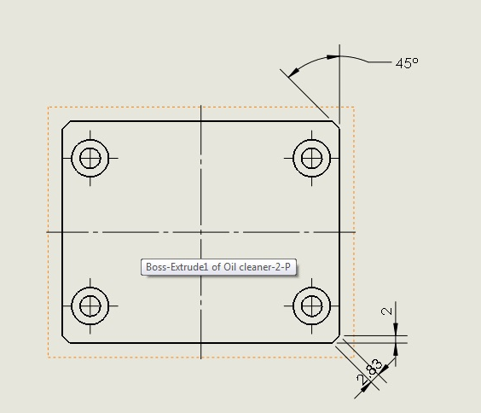
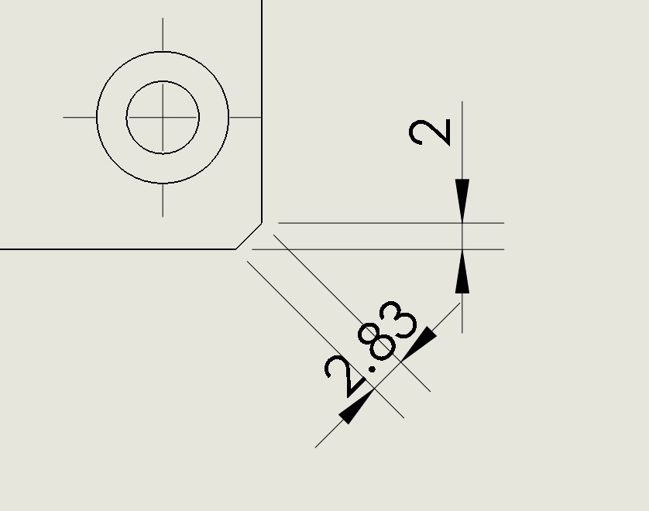
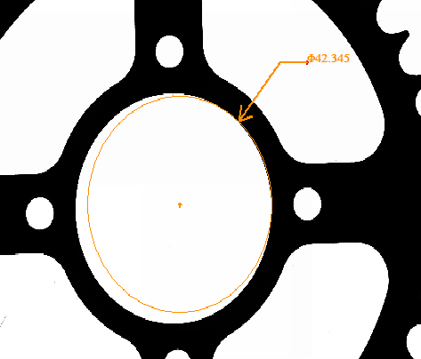
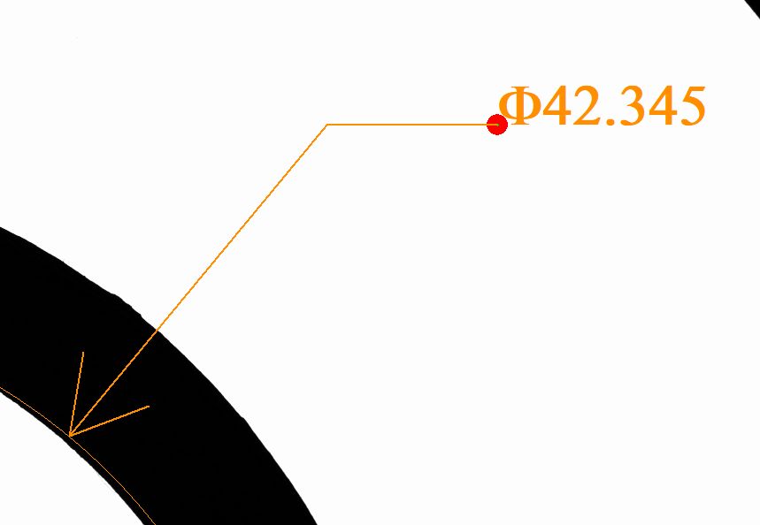

Slide 19
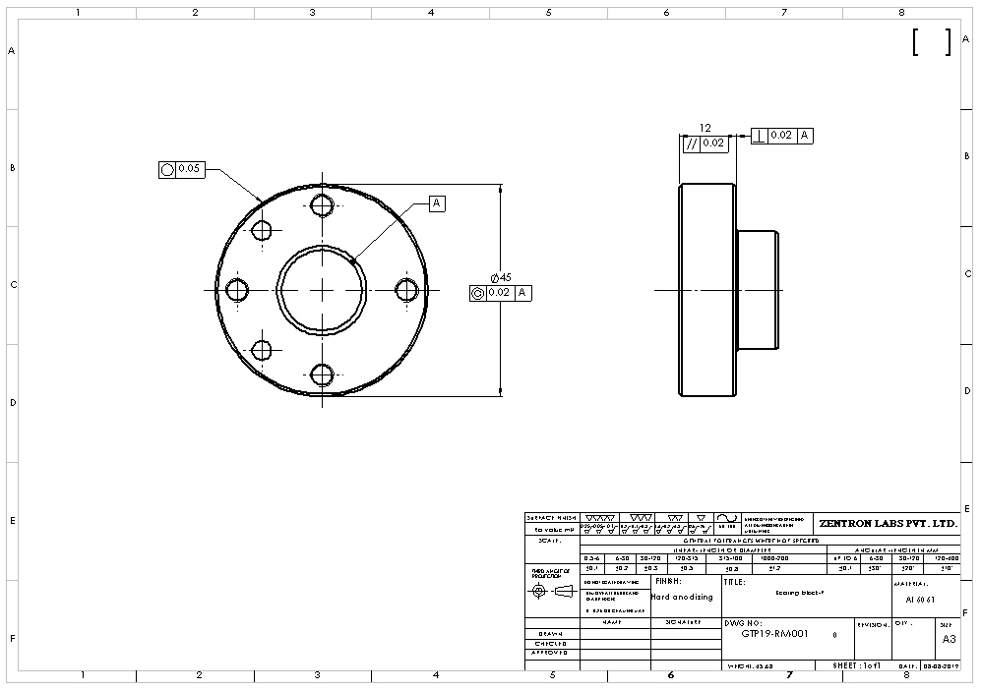
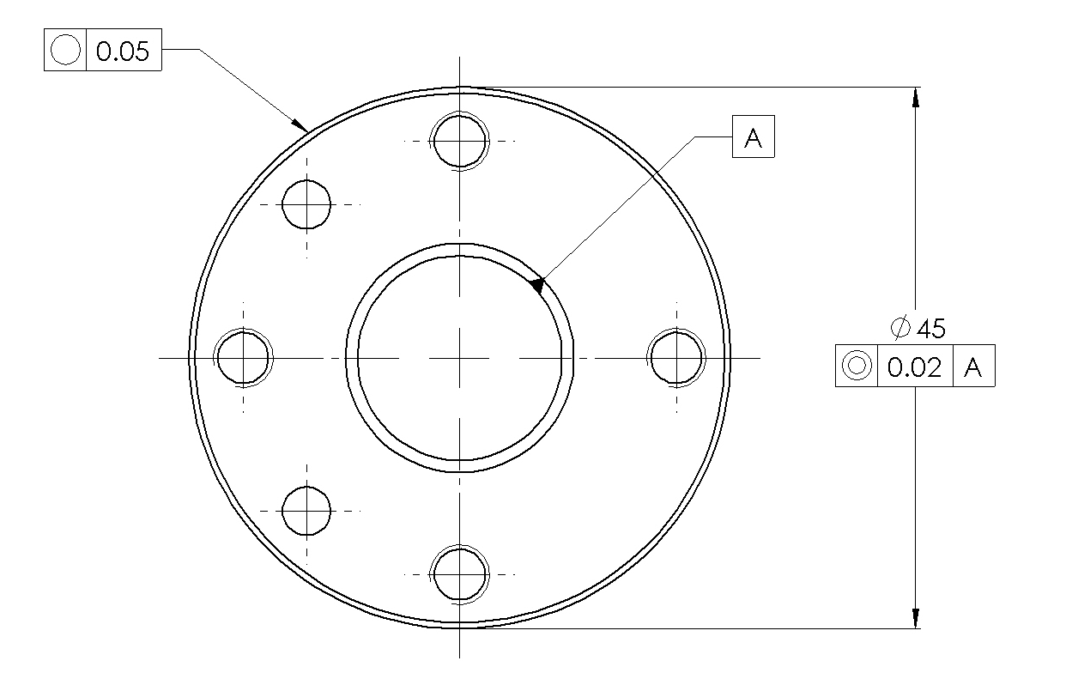

Zoom to fit
Zoomed in
Zoomed in 2

Slide 20
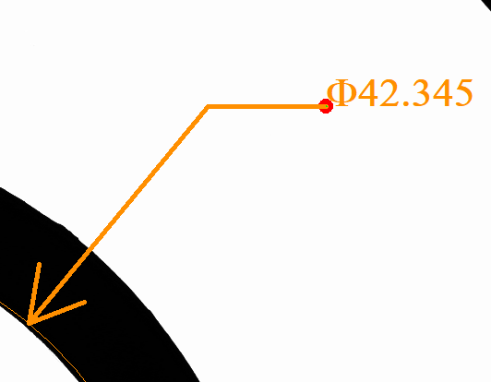
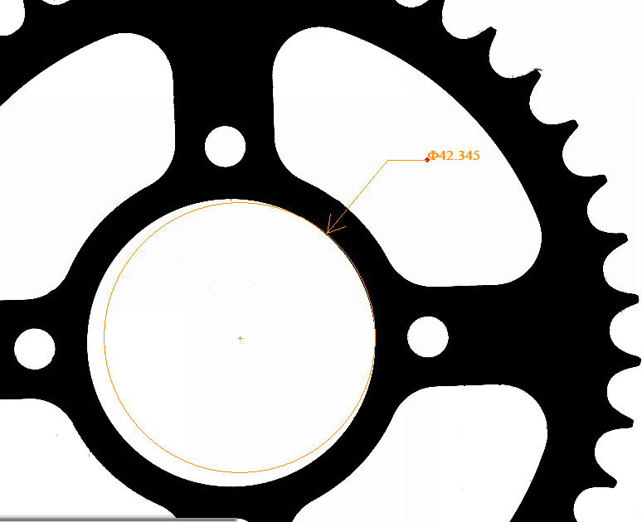
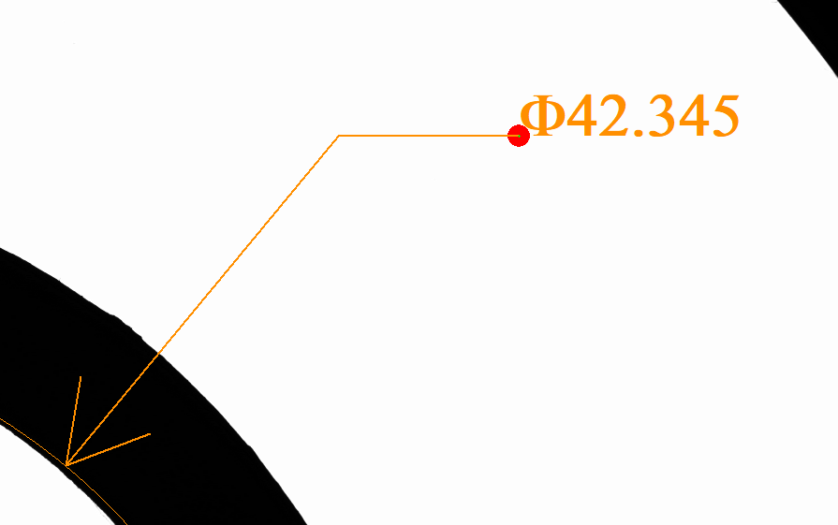
Zooming experience (Dynamic and Static)
Zoom factor : 0.5x
(Dynamic)
Zoom factor : 0.5x
(Static)
Zoom factor : 0.13x

Slide 21
Zooming experience (Speed consideration)
Comparison demo for Solid Works and LabVIEW
Possible solutions :
Merging of image overlays
Timing peak analysis

Slide 22
2. iv. Text overlay configuration
Font family
Font size

Slide 23




2. v. Overlay colour codes
Orange – (255,153,0) - All feature detection
Blue – (0,102,204) – Measurement
Green – (153,255,51) – ROI
Red – (255,0,0) – Failed measurements

Slide 24
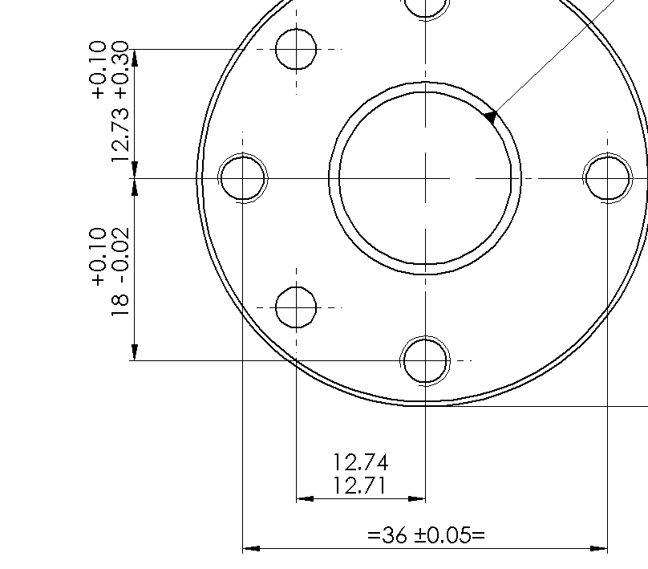
2. vi. Some types of tolerance display
Bilateral upper bound
Bilateral
Limits
Unilateral

Slide 25
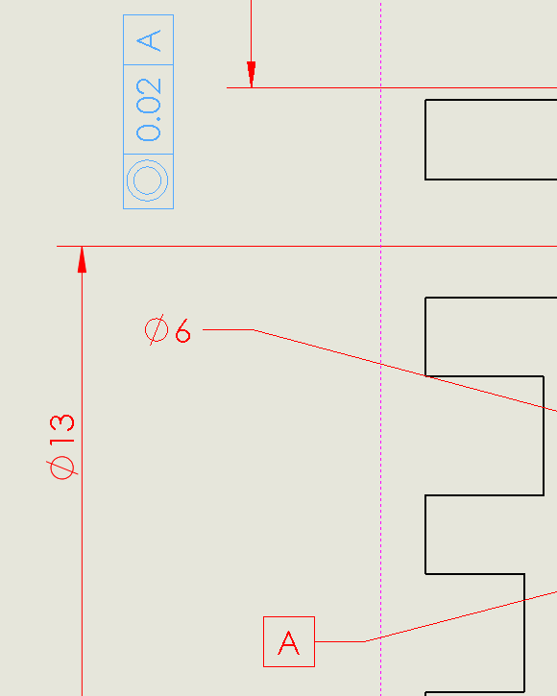
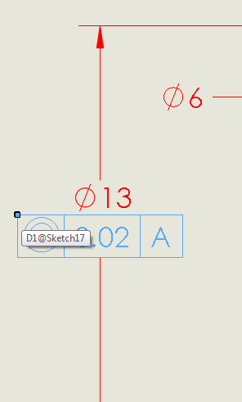
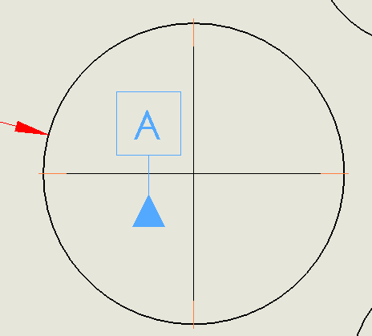
2. vii. Floating overlay

Slide 26
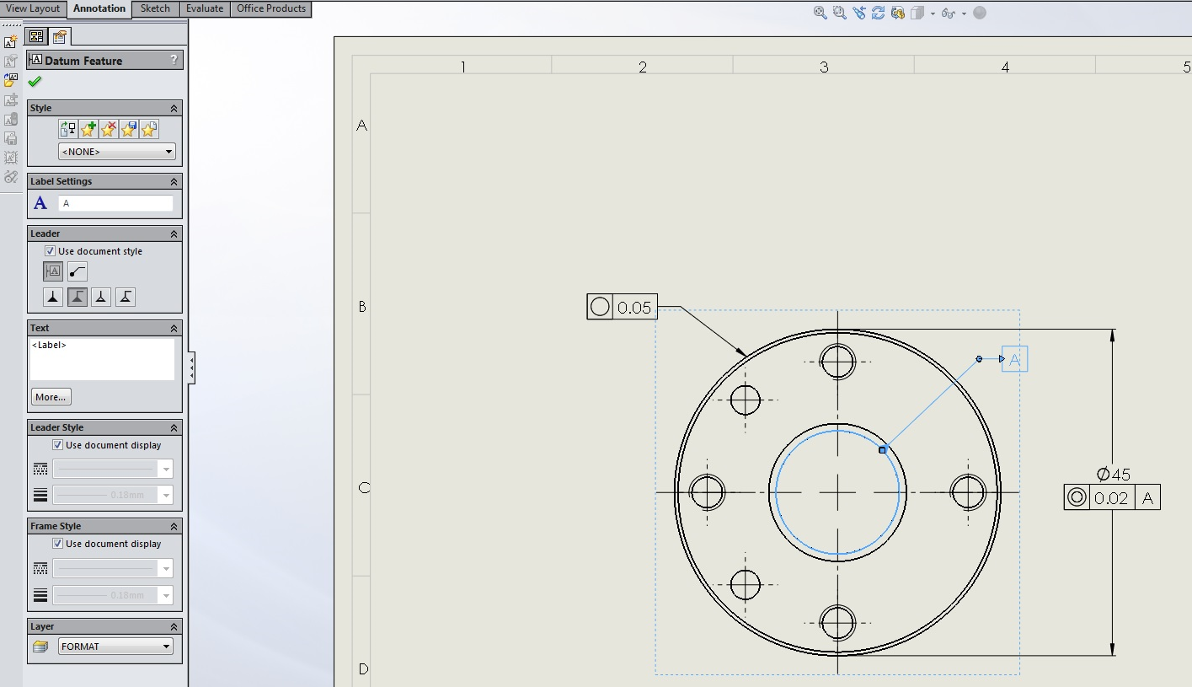
Overlay configuration window

Slide 27
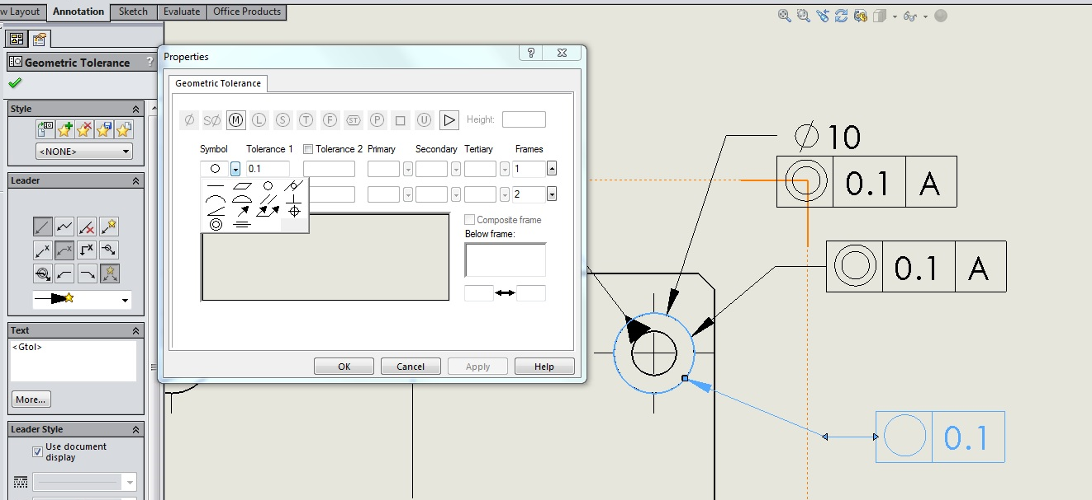
Sample GD&T configuration page

Slide 28
